Slide 1
MERSTHAM BAPTIST CHURCH
Exodus 26-27
The Tabernacle

Slide 2
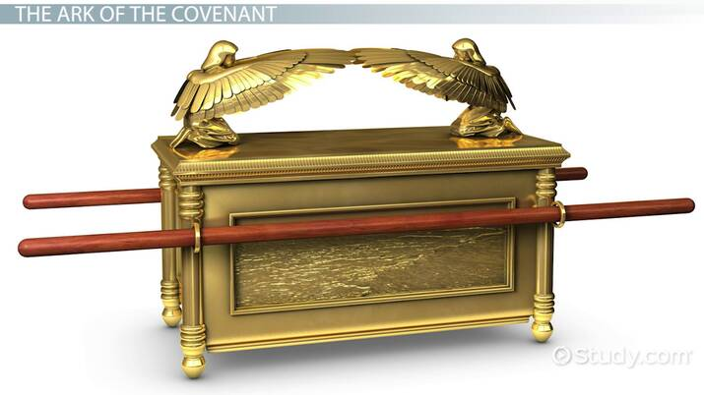

Slide 3
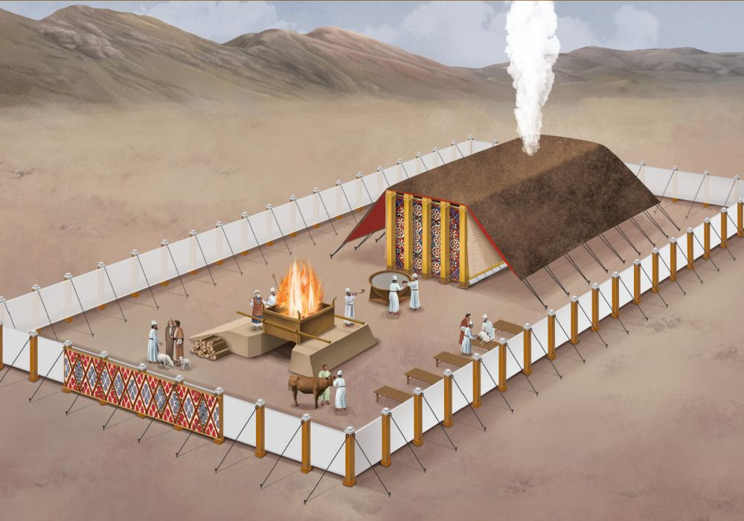
GREENWAY
ASSOCIATES
…also After

Slide 5
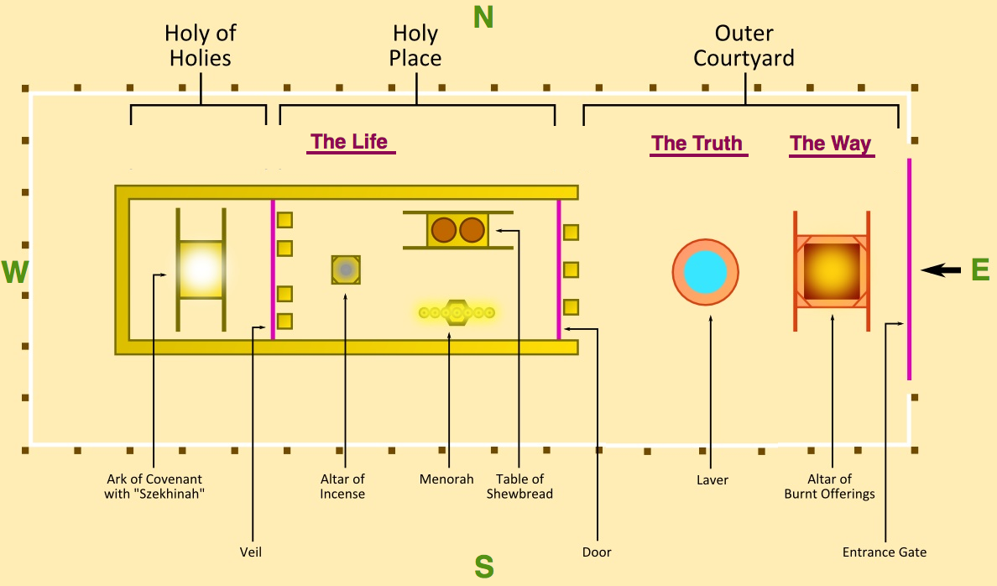

Slide 6
