Slide 1
Reaching out in Faith

Slide 2
Abraham

Slide 3
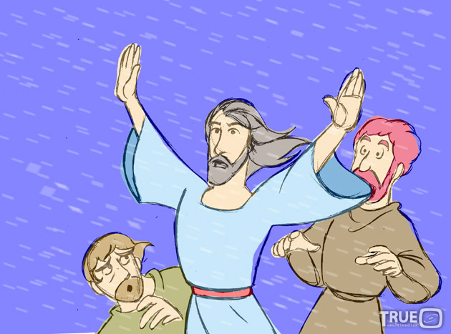
A Healthy Fear of God!
Notes:
Matthew 8.26 - And Jesus answered, “Why are you afraid? You have so little faith!” Then he stood up and rebuked the wind and waves, and suddenly all was calm.

Slide 4
Large Crowds Followed Jesus Wherever He Went
Matthew 4:23-25

Slide 5
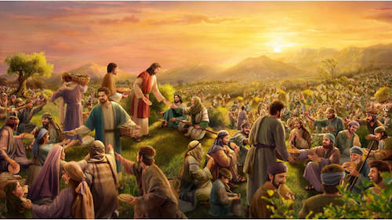

Slide 6
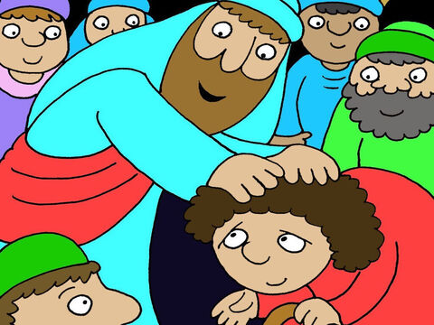
Reaching Out in Faith
Be Where Jesus is at Work

Slide 7
A Man with Leprosy
Matthew 8:1-3

Slide 8
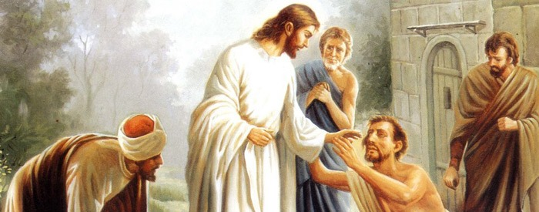

Slide 9
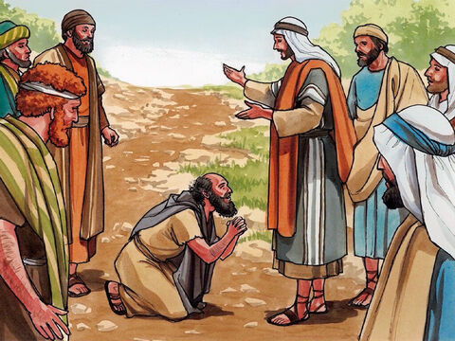
Reaching Out in Faith
Be Where Jesus is at Work
Ask for what you need

Slide 10
The Centurion’s Servant
Matthew 8:5-10 & 13

Slide 11
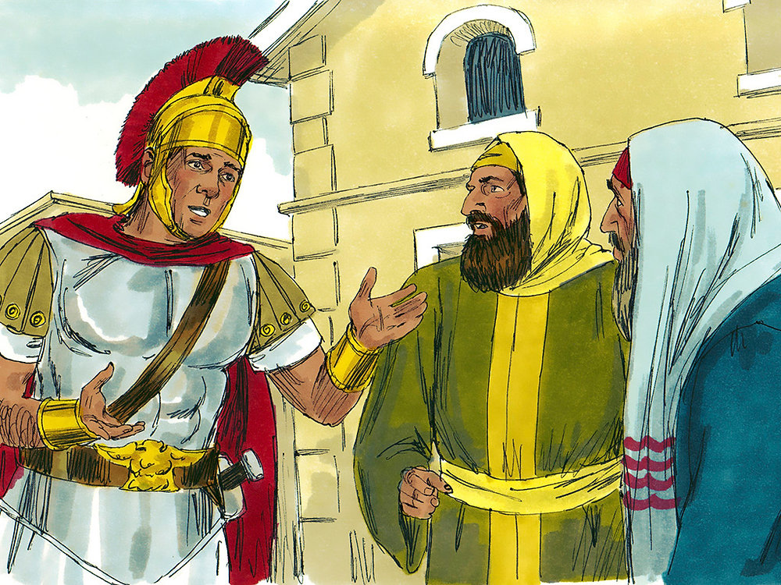

Slide 12
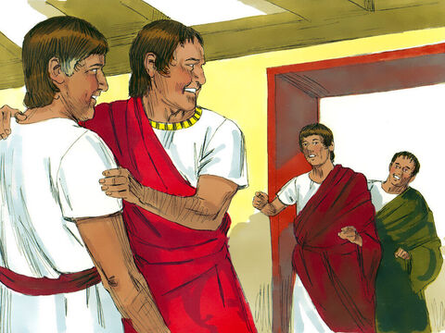
Reaching Out in Faith
Be Where Jesus is at Work
Ask for what you need
Know God’s Power & Authority

Slide 13
Jairus’ Daughter Reaching out to God
Matthew 9 8-19, 23-26

Slide 14
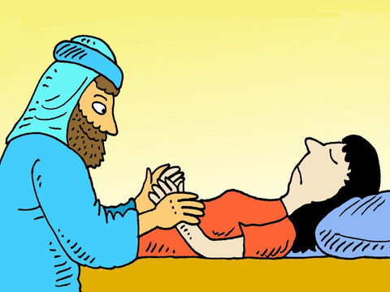

Slide 15
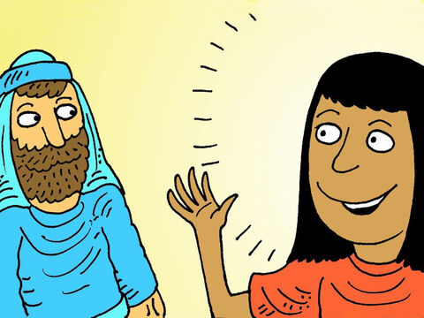
Reaching Out in Faith
Be Where Jesus is at Work
Ask for what you need
Knowing God’s Power & Authority
Don’t be Cynical

Slide 16
The Woman with an Issue of Blood
Matthew 9:2-22

Slide 17
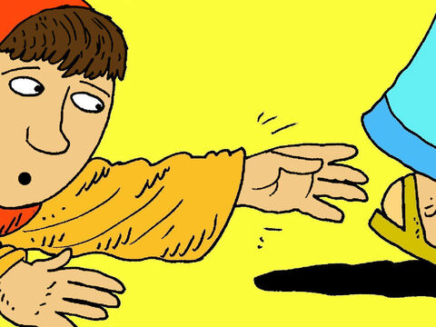

Slide 18
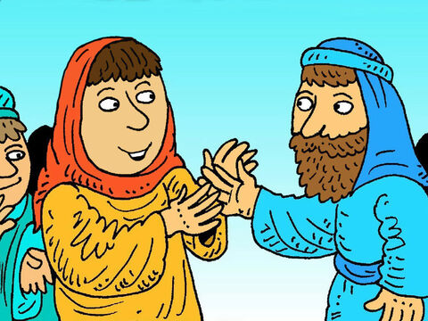
Reaching Out in Faith
Be Where Jesus is at Work
Ask for what you need
Knowing God’s Power & Authority
Don’t be Cynical
Reach Out to Jesus

Slide 19
Peter Walks on Water Reaching out to God
Matthew 14:22-33

Slide 20
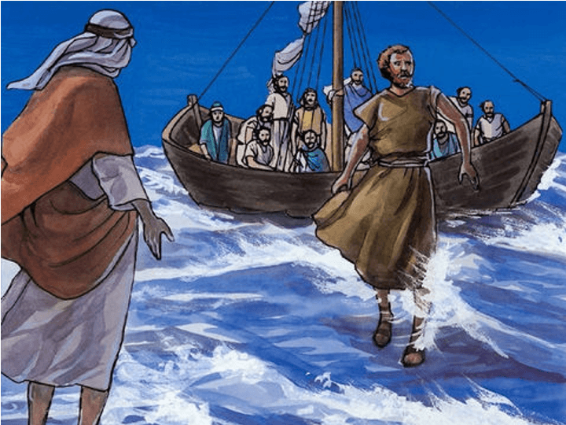

Slide 21
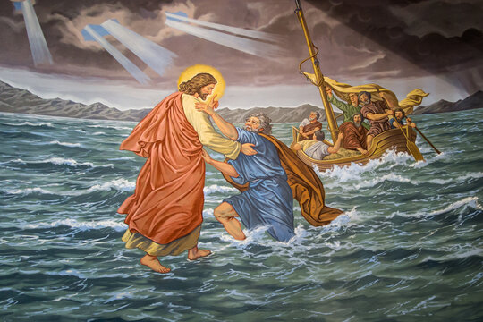
Reaching Out in Faith
Be Where Jesus is at Work
Ask for what you need
Knowing God’s Power & Authority
Don’t be Cynical
Reach Out to Jesus
Lord, is it You?

Slide 22
How do we Know that it is God? Reaching out to God

Slide 23
Jesus Sends Out His Disciples Matthew 10:1 & 5-8 (NLT2)

Slide 24
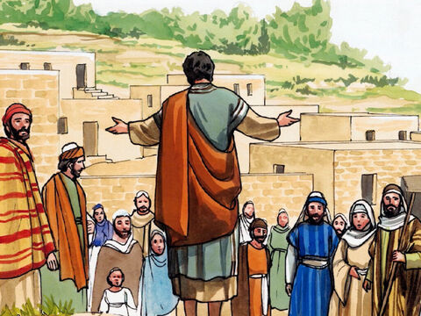

Slide 25
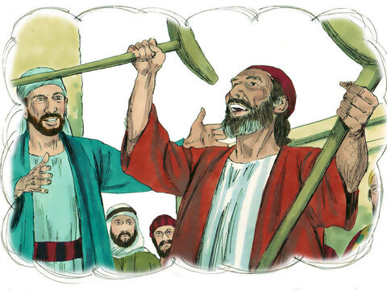
The Mission
Announce that the Kingdom of Heaven is near
Heal the sick
Raise the dead
Cure those with leprosy
Cast out demons

Slide 26
Will You Take a Step of Faith Today?

